Slide 1
VXT2 Evaluation
Speaker Title / Company Name
YYYY.MM.DD
Speaker Name

Slide 2
PA_TOI Test
PA_TOIout Org:
Power out=0dBm
DAC_Nbits=14
GainImbalance=0.002
IQ offset=0.0044
Phase Noise =[100, -97.133, 1000, -106.072, 1e4, -118.607];
PA_TOI=30
PA_TOIout Change 10dB:
Power out=0dBm
DAC_Nbits=14
GainImbalance=0.002
IQ offset=0.0044
Phase Noise =[100, -97.133, 1000, -106.072, 1e4, -118.607];
PA_TOI=20
PA_TOIout Change 15dB:
Power out=0dBm
DAC_Nbits=14
GainImbalance=0.002
IQ offset=0.0044
Phase Noise =[100, -97.133, 1000, -106.072, 1e4, -118.607];
PA_TOI=15

Slide 3
PA_TOI Test Compare
 | EVM(dB) |  |  | 1BW_Upper_ACLR |  |  | 1BW_Lower_ACLR
PA_TOI | VXT | Sim | Delta | VXT | Sim | Delta | VXT | Sim | Delta
30 | -48.458 | -49.843 | 1.385 | 53.743 | 53.563 | 0.18 | 53.926 | 53.579 | 0.347
20 | -37.54 | -37.974 | 0.434 | 43.945 | 44.369 | 0.424 | 44.108 | 44.426 | 0.318
15 | -27.581 | -27.651 | 0.07 | 34.283 | 34.43 | 0.147 | 34.456 | 34.501 | 0.045

Slide 4
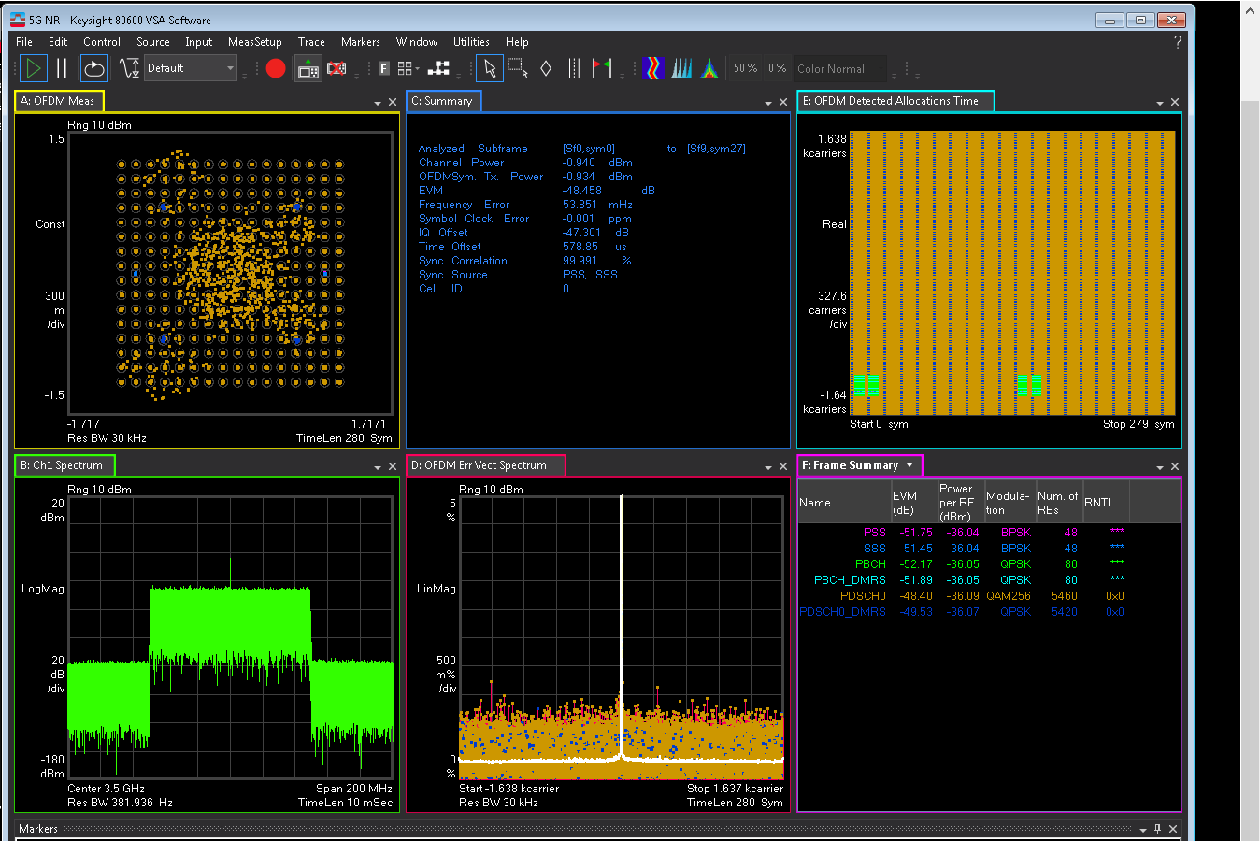
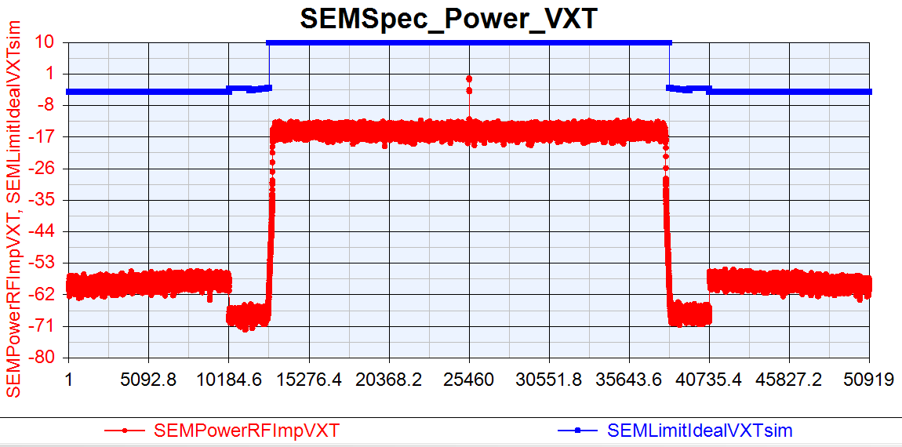
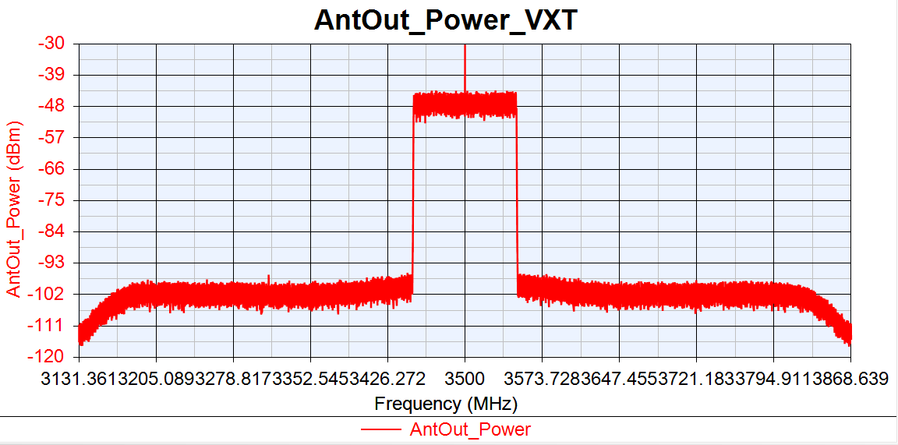
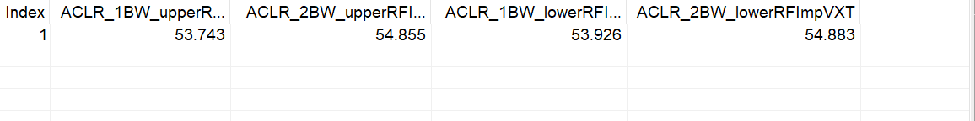
VXT_TOI=30
EVM:-48.458dB
IQoffset:-47.301dB

Slide 5
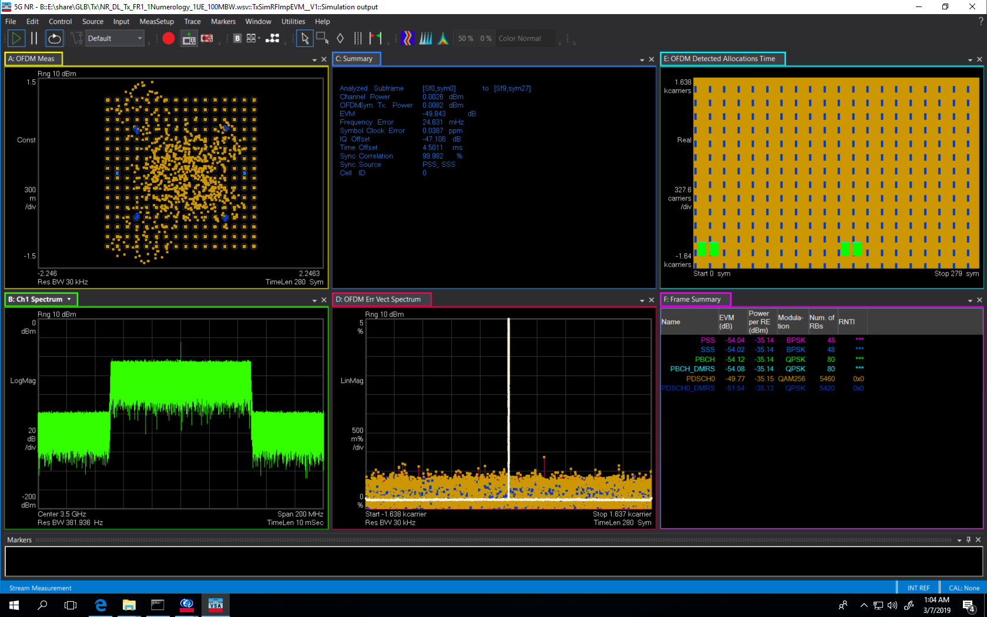

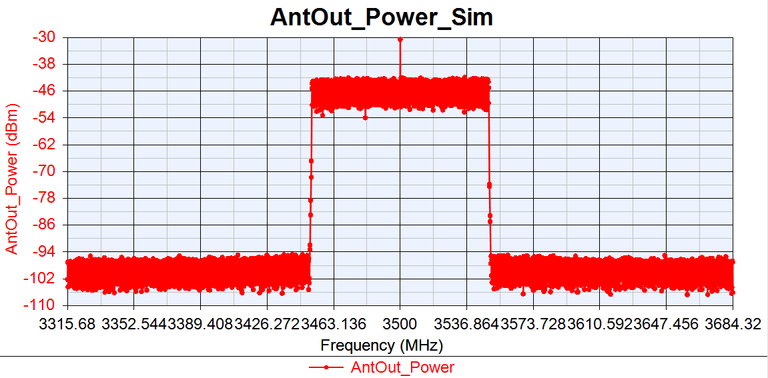
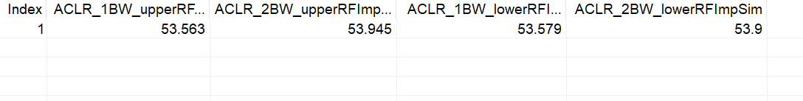
Sim_TOI=30
EVM:-49.843dB
IQoffset:-47.106dB

Slide 6
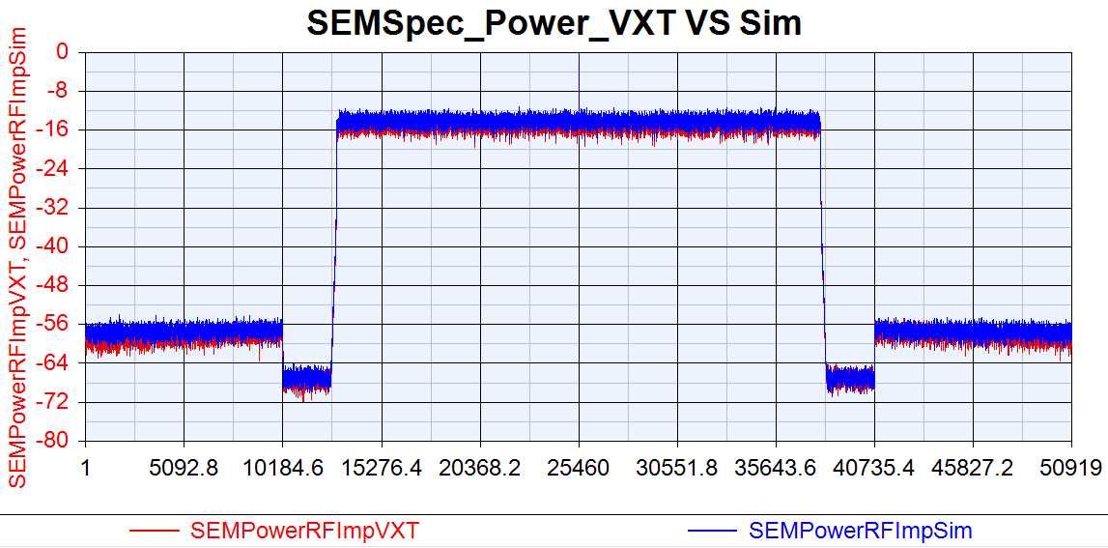
VXT SEM VS Sim SEM

Slide 7
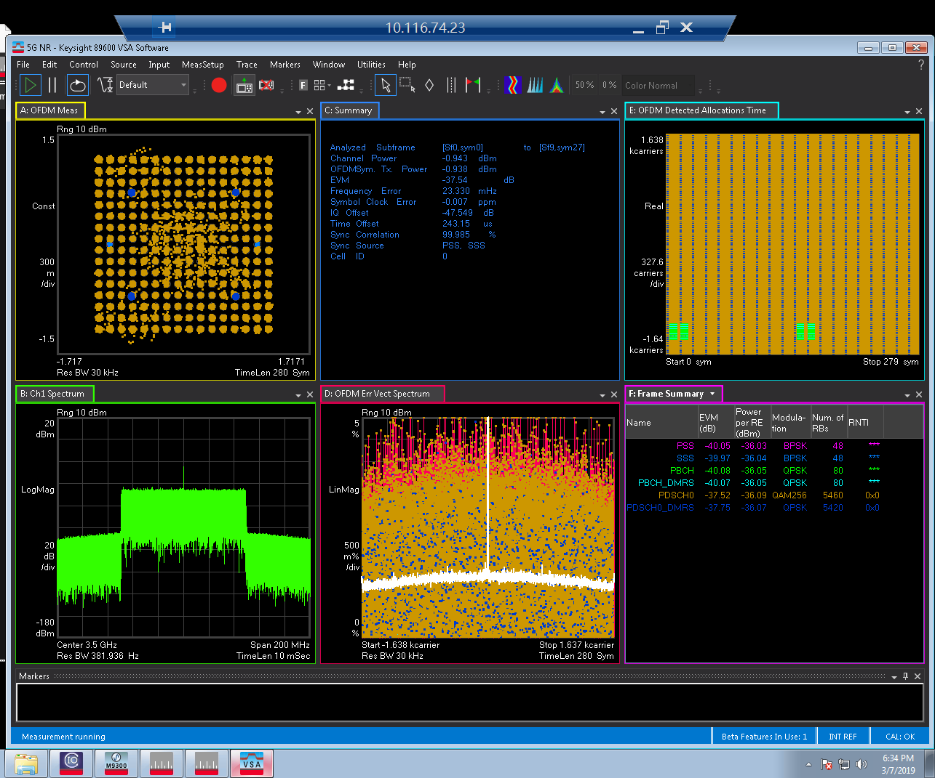
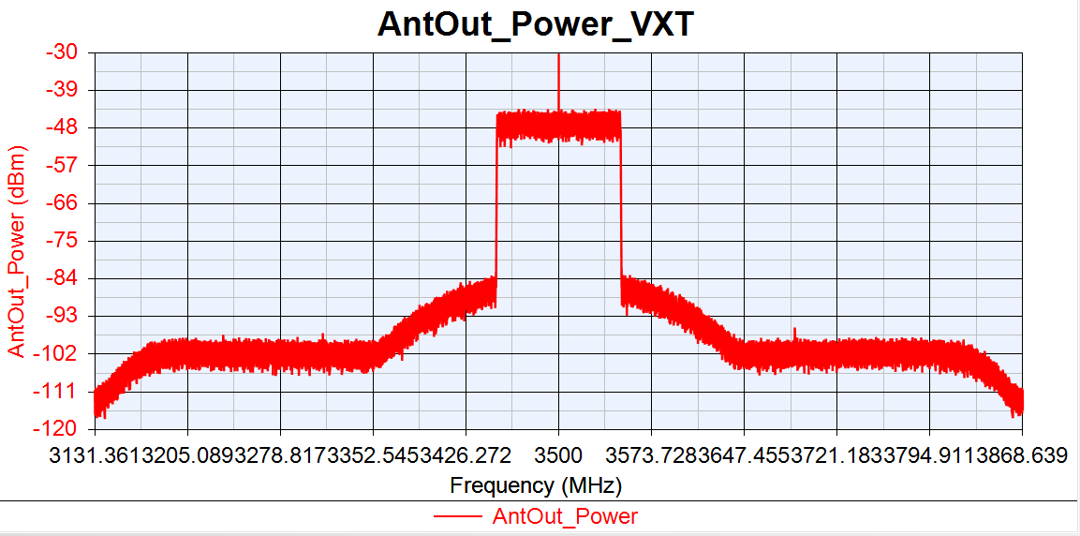
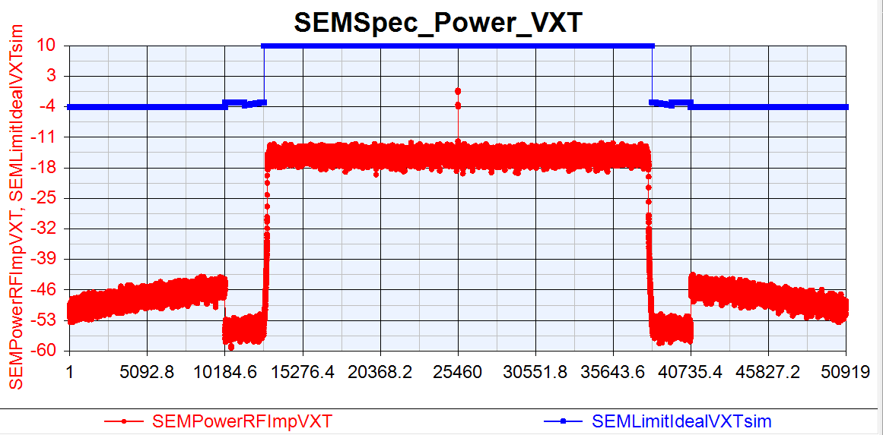
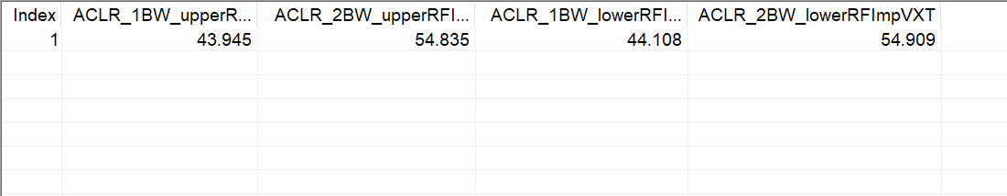
VXT_TOI=20
EVM:-37.54dB
IQoffset:-47.549dB

Slide 8
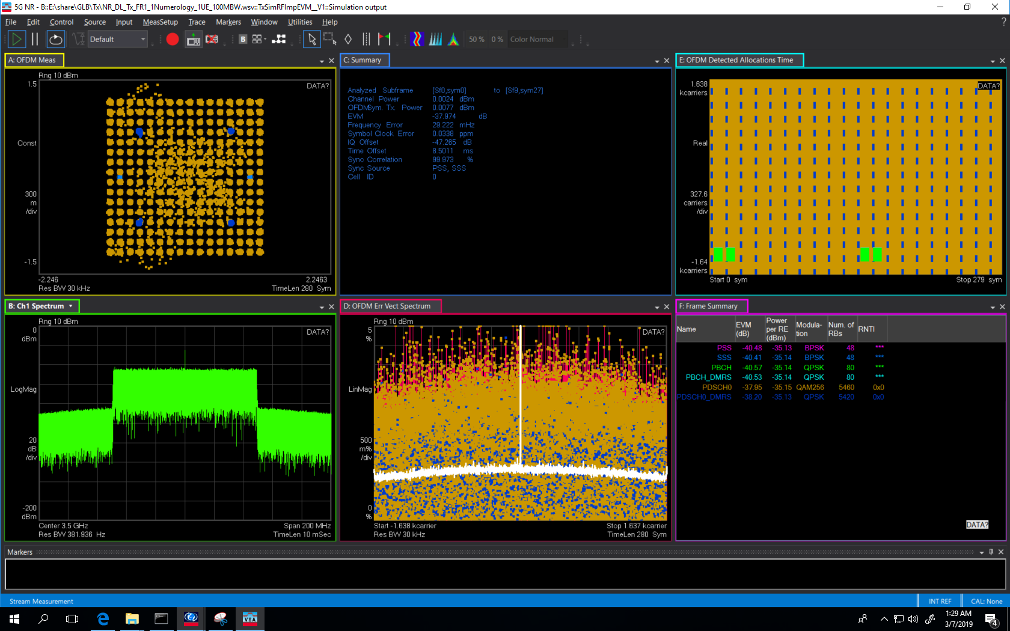
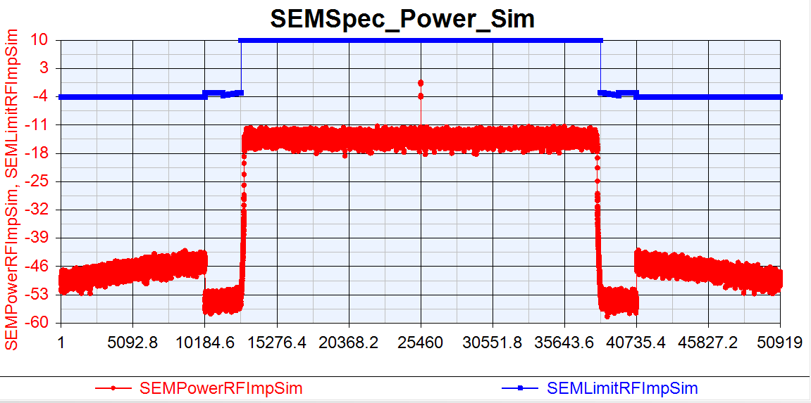
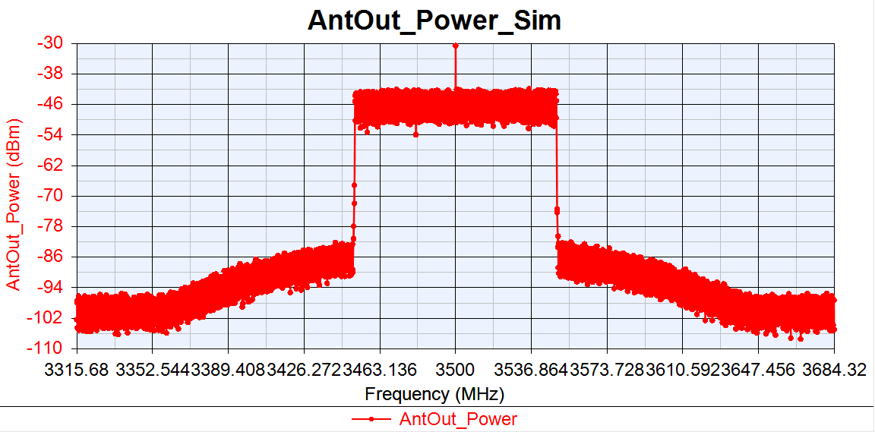
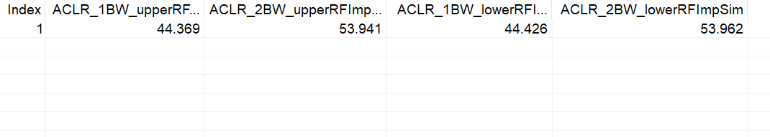
Sim_TOI=20
EVM:-37.974dB
IQoffset:-47.265dB

Slide 9
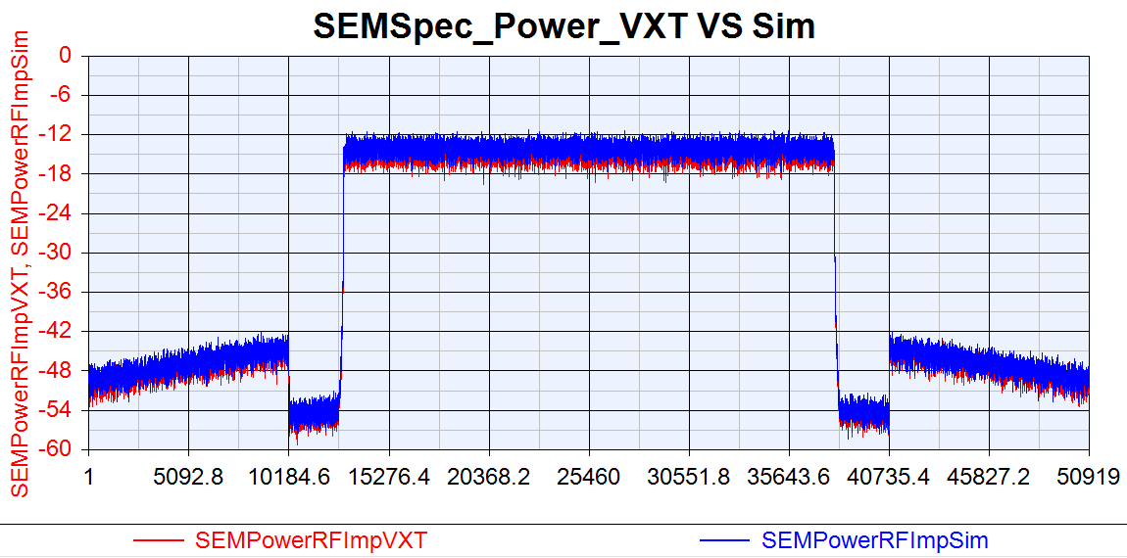
VXT SEM VS Sim SEM

Slide 10
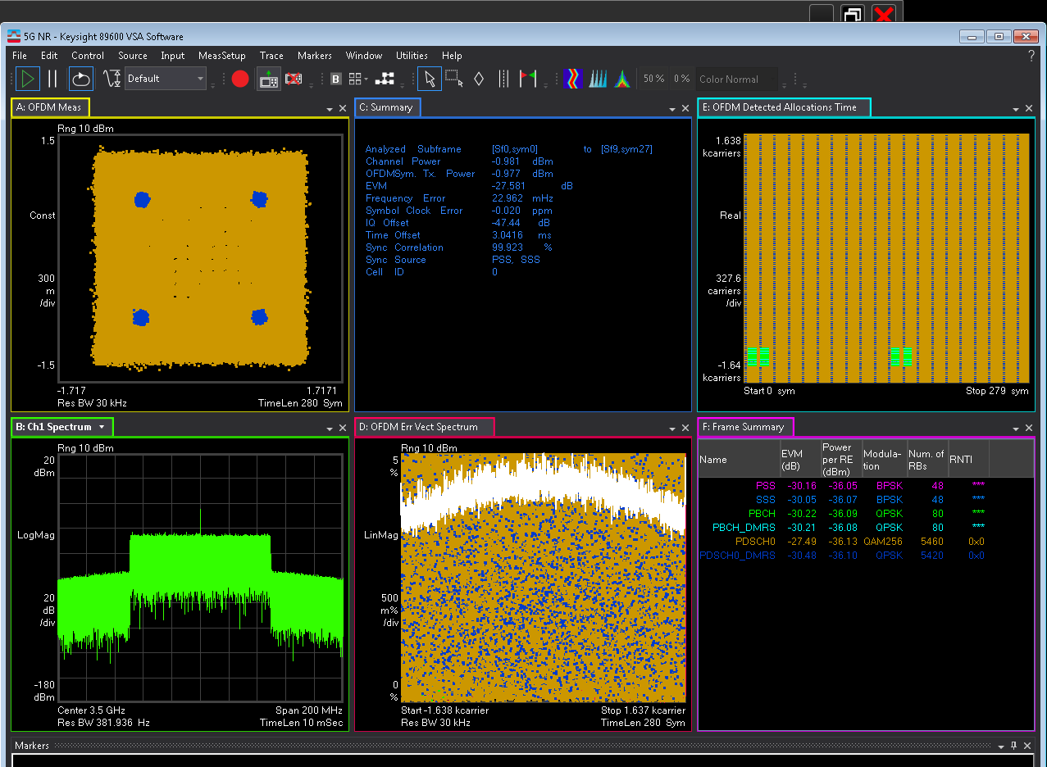
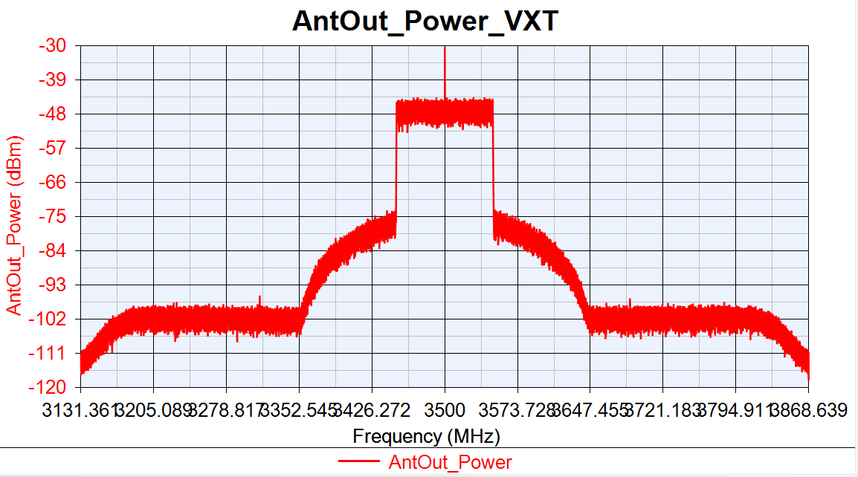
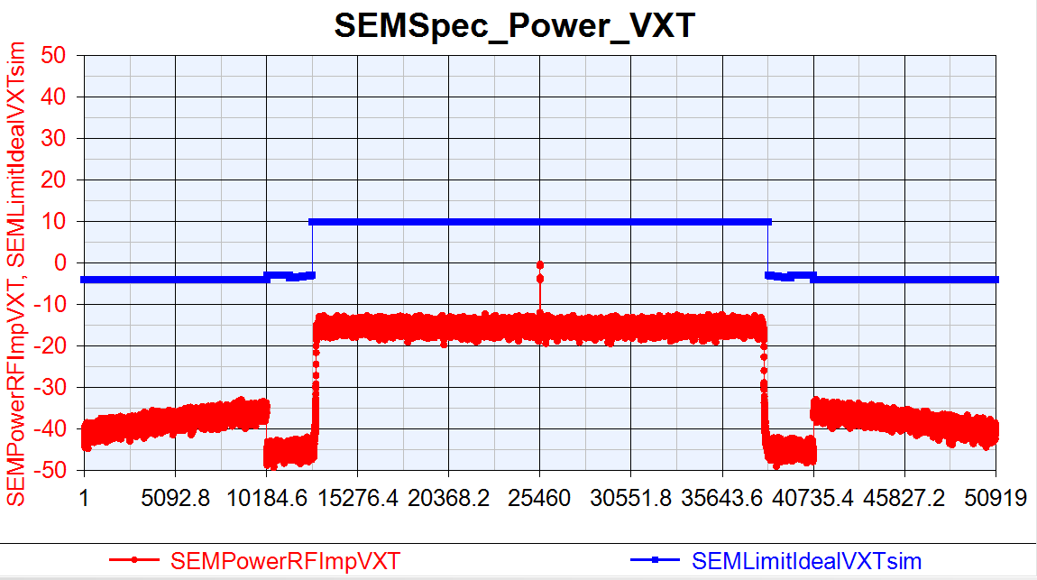
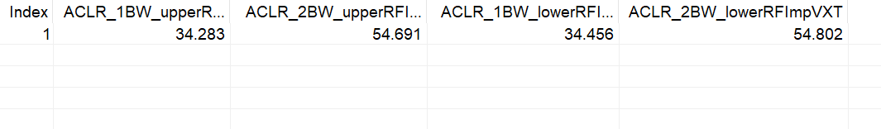
VXT_TOI=15
EVM:-27.581dB
IQoffset:-47.44dB

Slide 11
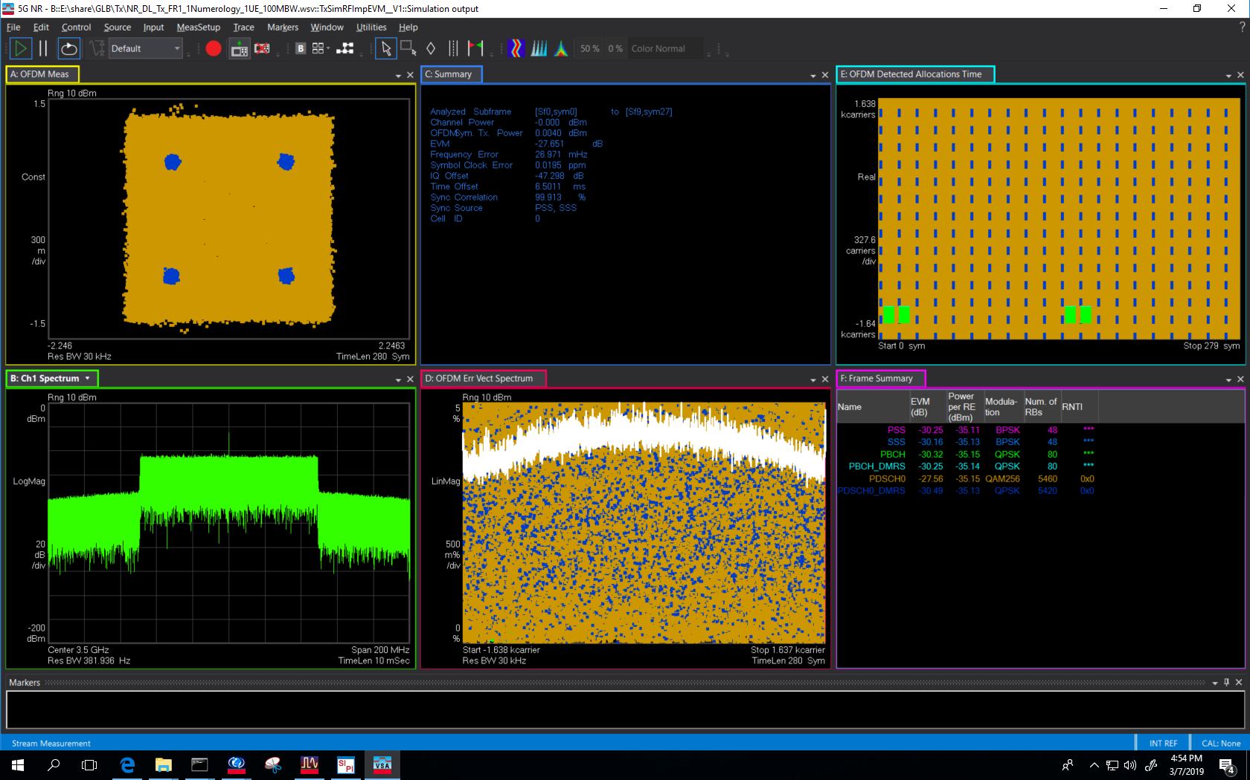
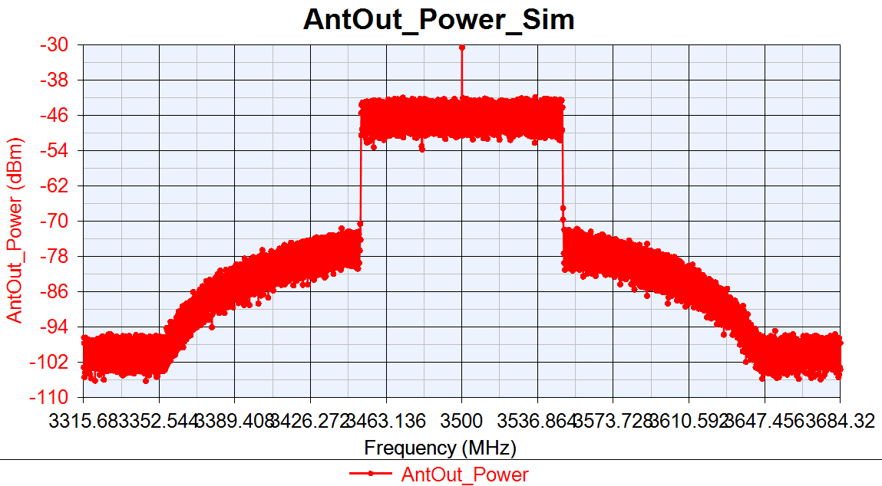
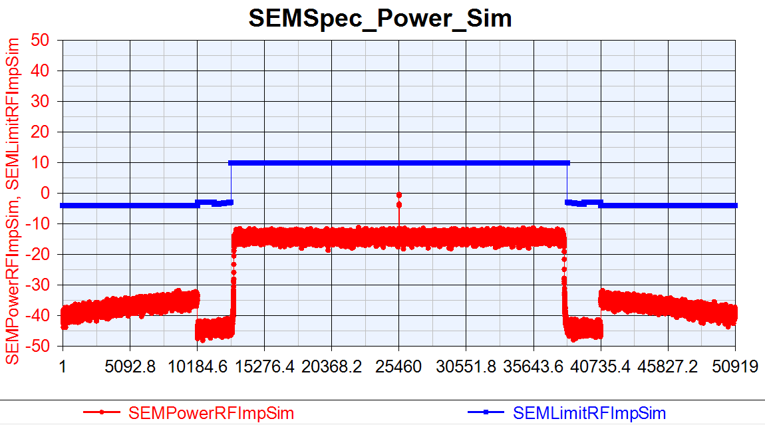
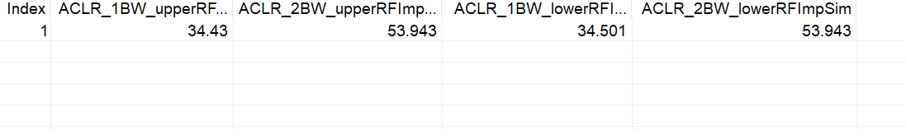
Sim_TOI=15
EVM:-27.651dB
IQoffset:-47.298dB

Slide 12
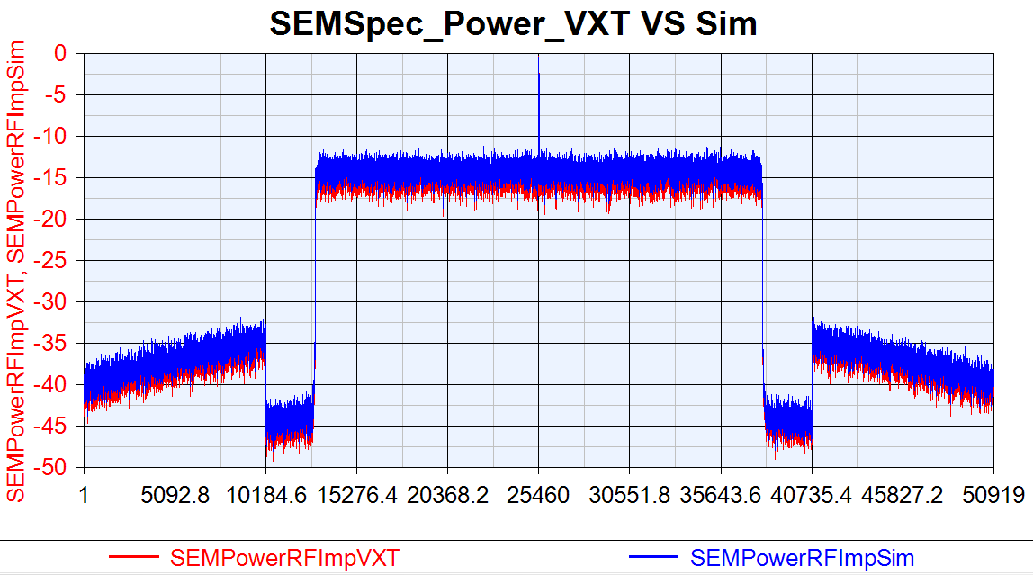
VXT SEM VS Sim SEM

Slide 13
Phase Noise Test
Phase Noise Change 10dB:
Power out=0dBm
DAC_Nbits=14
GainImbalance=0.002
IQ offset=0.0044
Phase Noise =[100, -87.133, 1000, -96.072, 1e4, -108.607];
PA_TOIout=30
Phase Noise Change 15dB:
Power out=0dBm
DAC_Nbits=14
GainImbalance=0.002
IQ offset=0.0044
Phase Noise =[100, -82.133, 1000, -91.072, 1e4, -103.607];
PA_TOIout=30

Slide 14
Phase Noise Test
Phase Noise Change 35dB:
Power out=0dBm
DAC_Nbits=14
GainImbalance=0.002
IQ offset=0.0044
Phase Noise =[100, -62.133, 1000, -71.072, 1e4, -83.607];
PA_TOIout=30
Phase Noise Change 40dB:
Power out=0dBm
DAC_Nbits=14
GainImbalance=0.002
IQ offset=0.0044
Phase Noise =[100, -57.133, 1000, -66.072, 1e4, -78.607];
PA_TOIout=30

Slide 15
Phase Noise Test Compare
 | EVM(dB) |  |  | 1BW_Upper_ACLR |  |  | 1BW_Lower_ACLR
Phase Noise | VXT | Sim | Delta | VXT | Sim | Delta | VXT | Sim | Delta
-10dB | -48.27 | -49.823 | 1.553 | 53.883 | 53.565 | 0.318 | 54.132 | 53.559 | 0.573
-15dB | -48.256 | -48.869 | 0.613 | 53.869 | 53.551 | 0.318 | 54.118 | 53.568 | 0.55
-35dB | -44.057 | -44.852 | 0.795 | 54.041 | 53.543 | 0.502 | 54.316 | 53.567 | 0.749
-40dB | -32.341 | -32.389 | 0.047 | 54.069 | 53.529 | 0.48 | 54.367 | 53.581 | 0.786

Slide 16
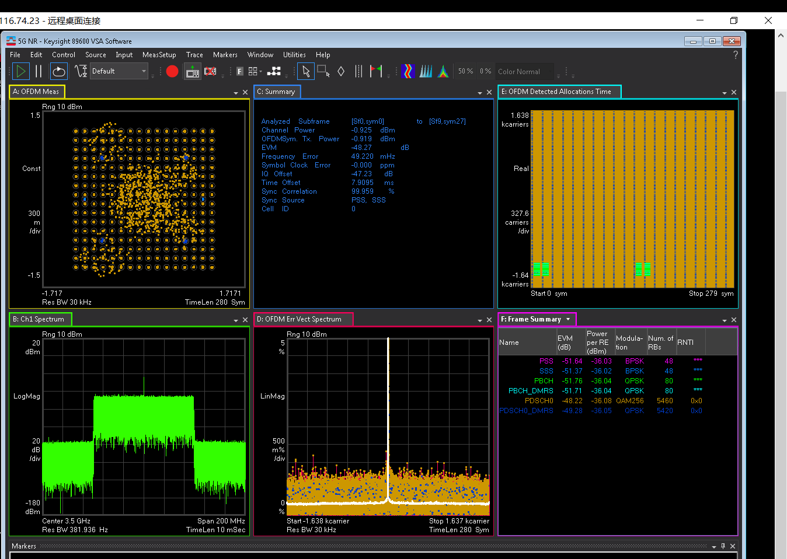
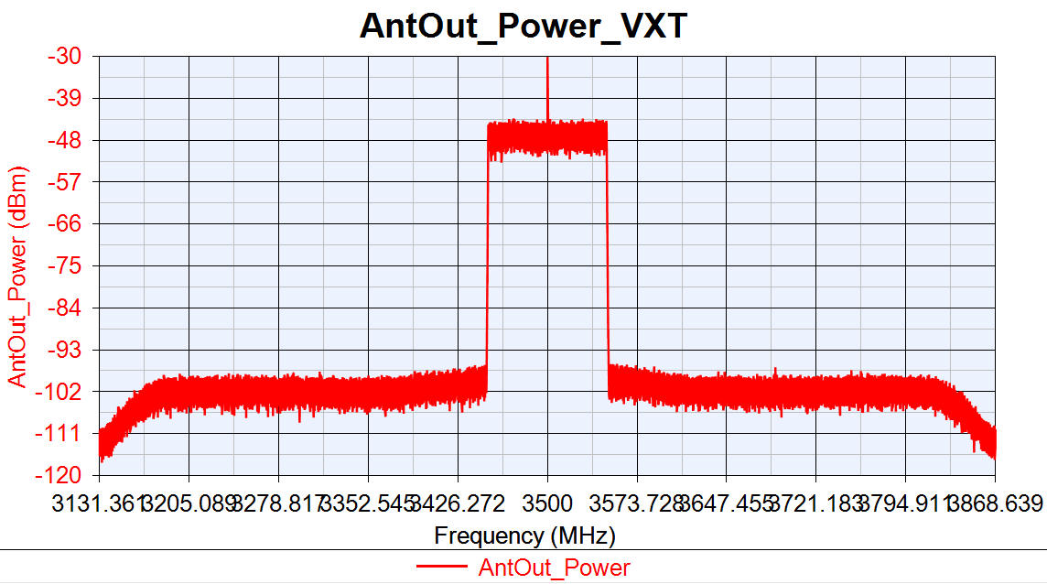
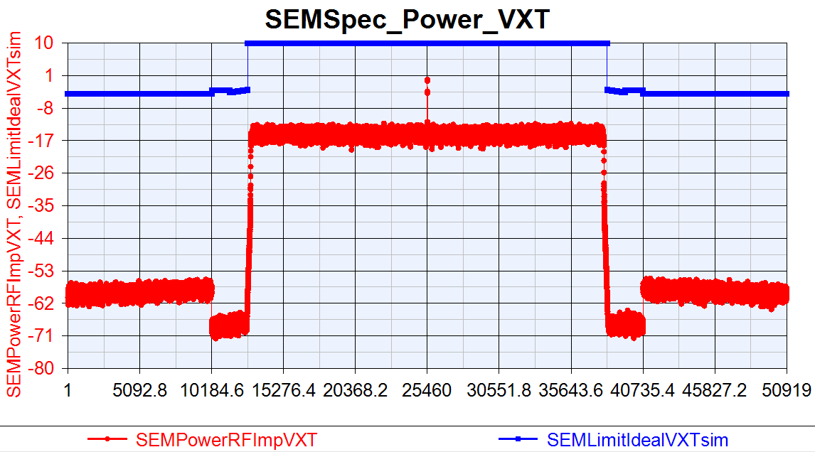
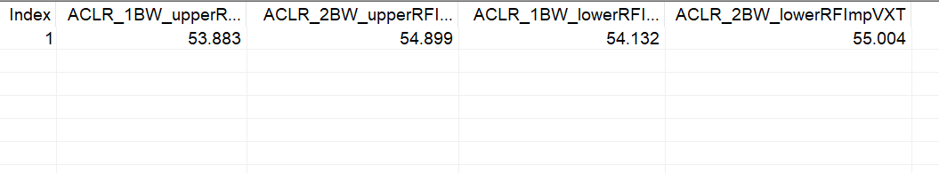
VXT_PhaseNoise =[100, -87.133, 1000, -96.072, 1e5, -108.607]
EVM:-48.27dB
IQoffset:-47.23dB

Slide 17
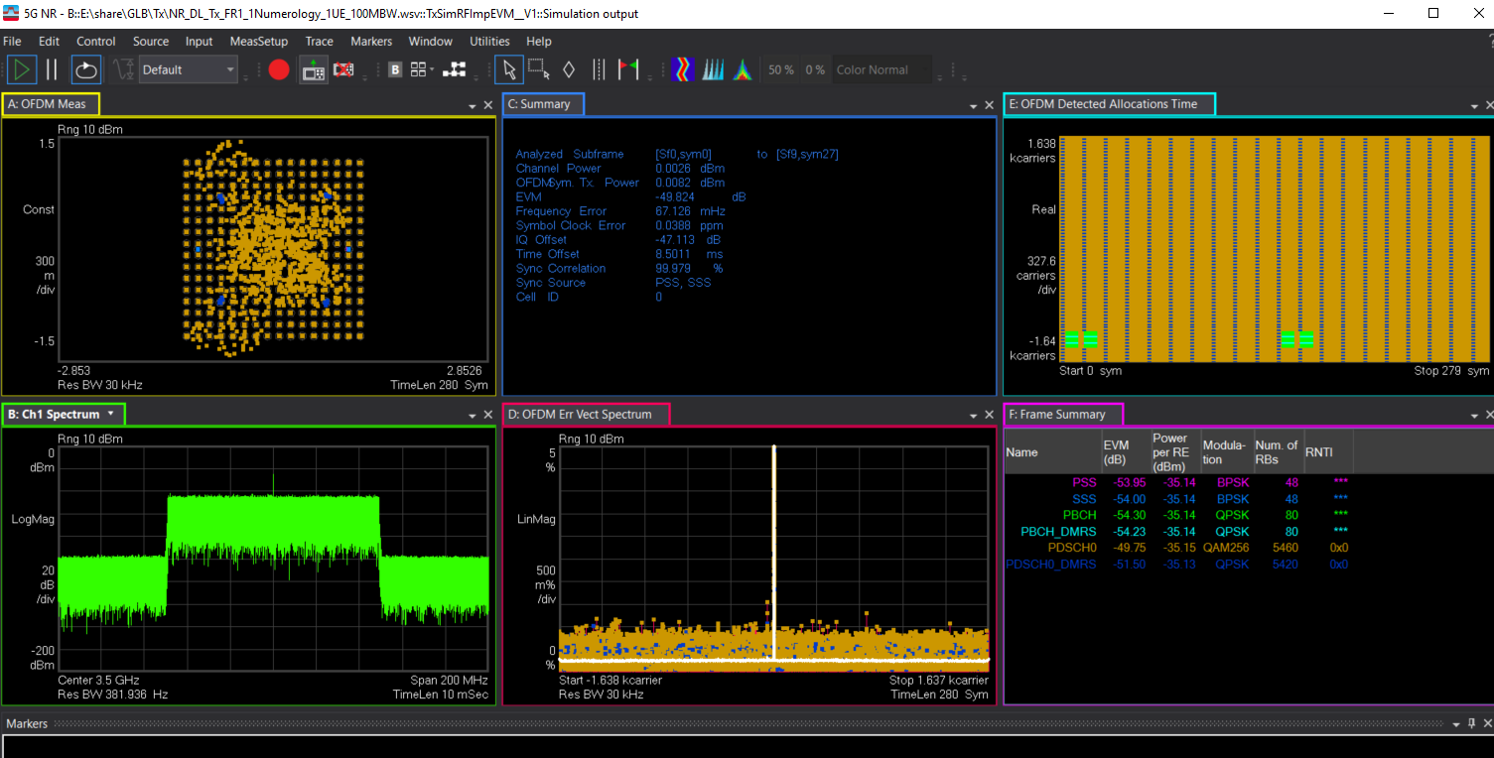
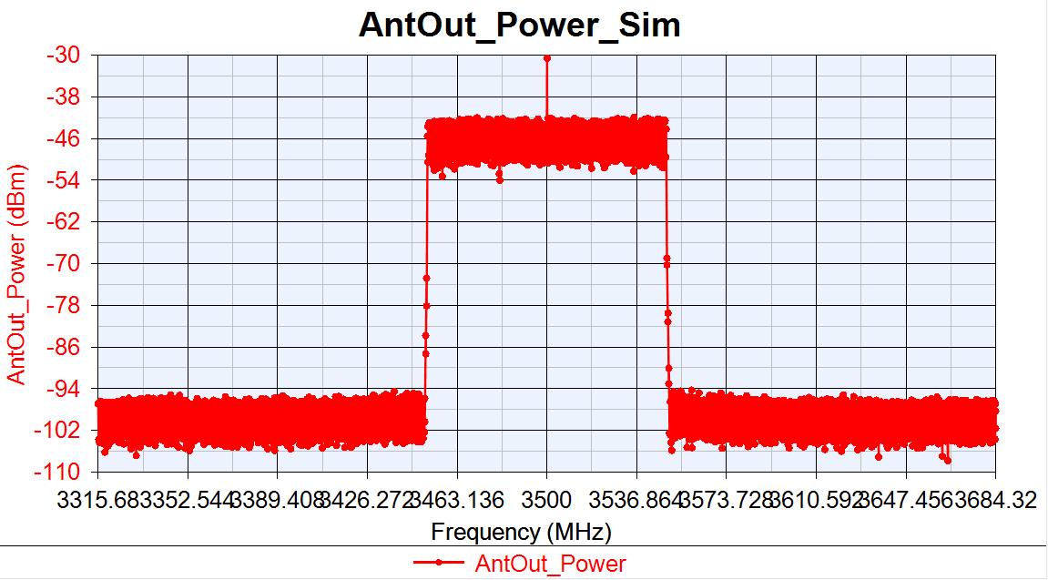

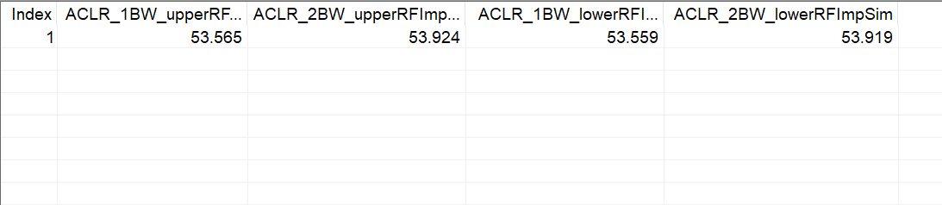
Sim_PhaseNoise =[100, -87.133, 1000, -96.072, 1e5, -108.607]
EVM:-49.824dB
IQoffset:-47.113dB

Slide 18
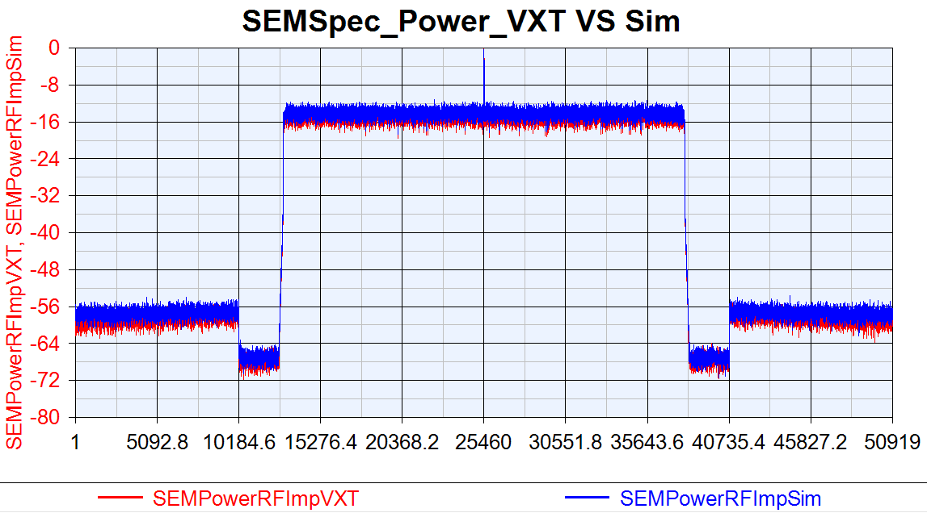
VXT SEM VS Sim SEM

Slide 19
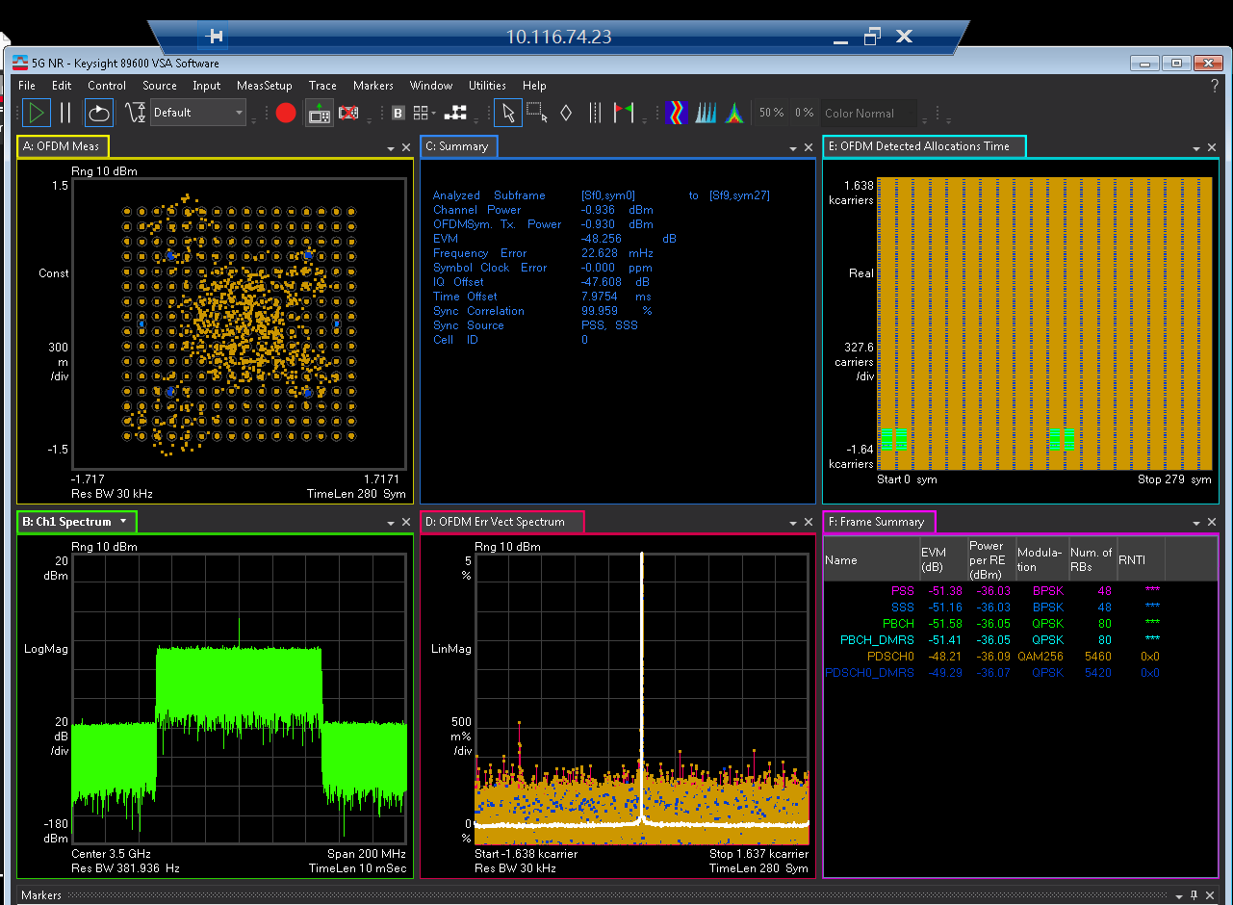
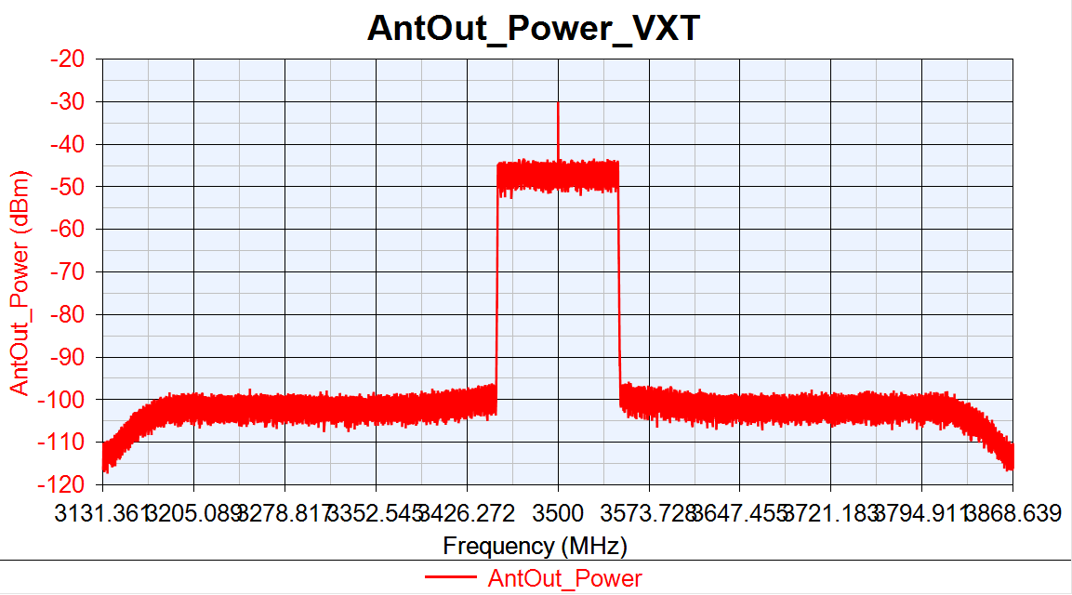
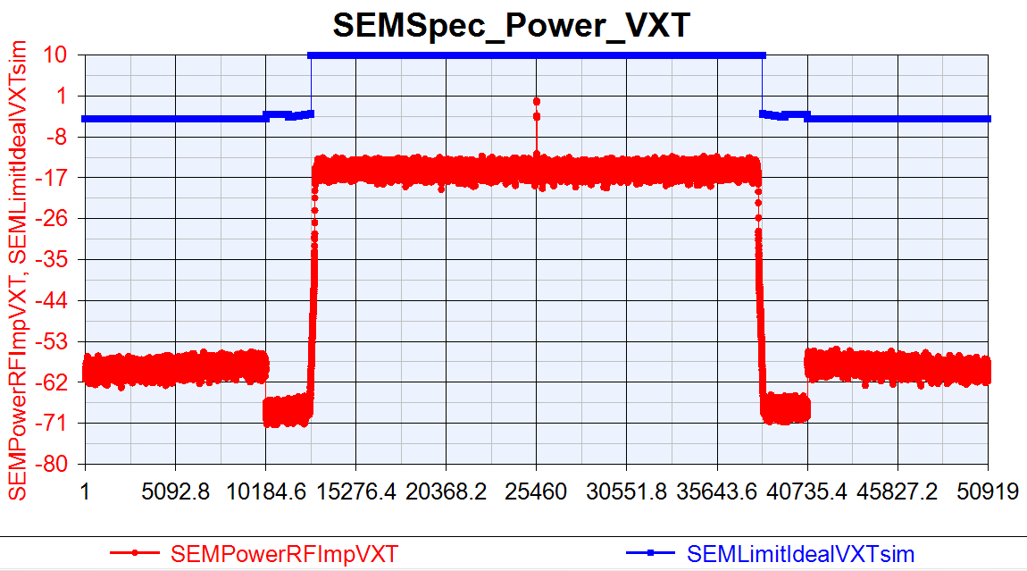
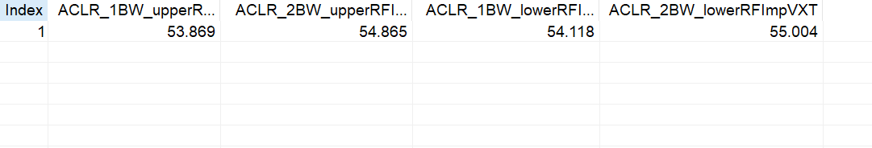
VXT_PhaseNoise =[100, -82.133, 1000, -91.072, 1e5, -103.607]
EVM:-48.256dB
IQoffset:-47.608dB

Slide 20
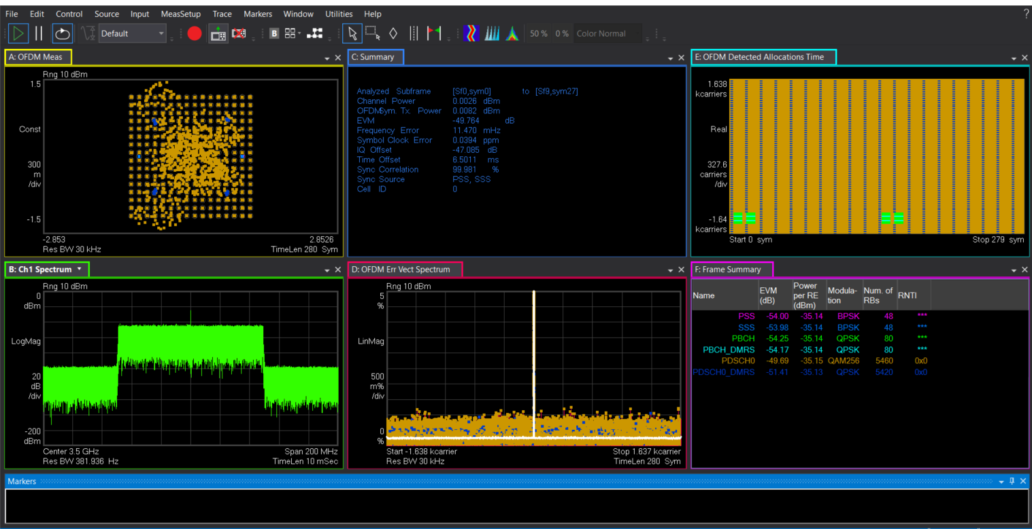

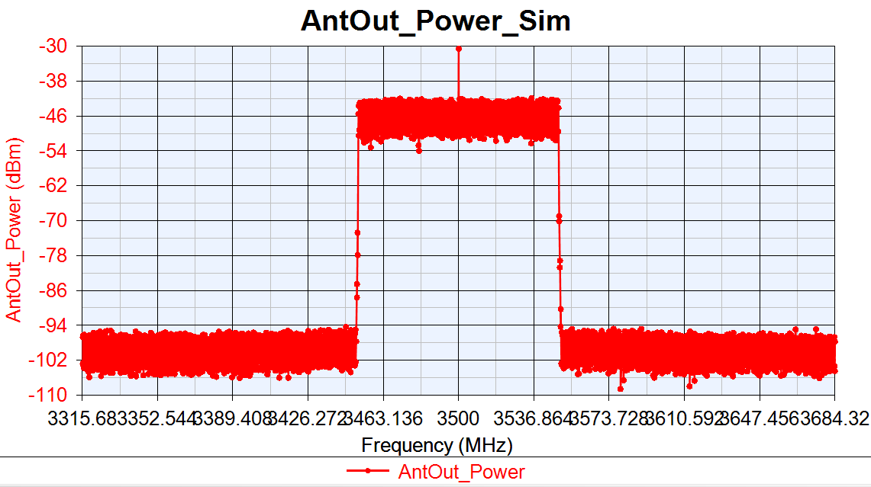
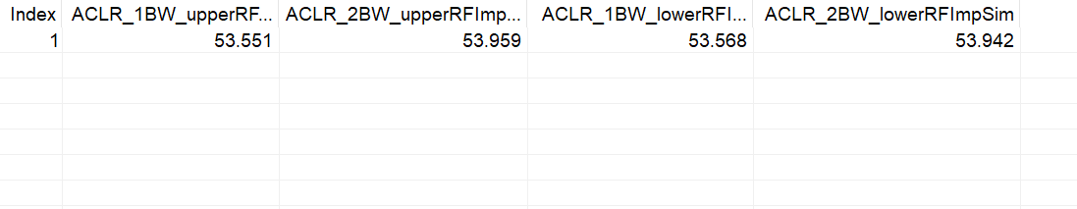
Sim_PhaseNoise =[100, -82.133, 1000, -91.072, 1e5, -103.607]
EVM:-48.764dB
IQoffset:-47.085dB

Slide 21
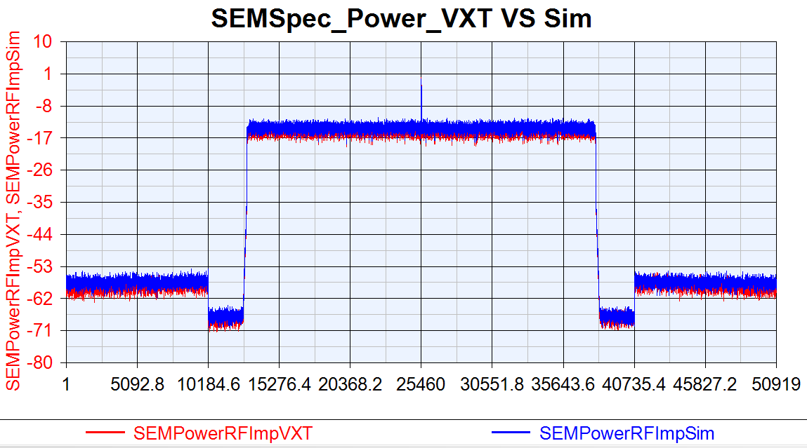
VXT SEM VS Sim SEM

Slide 22
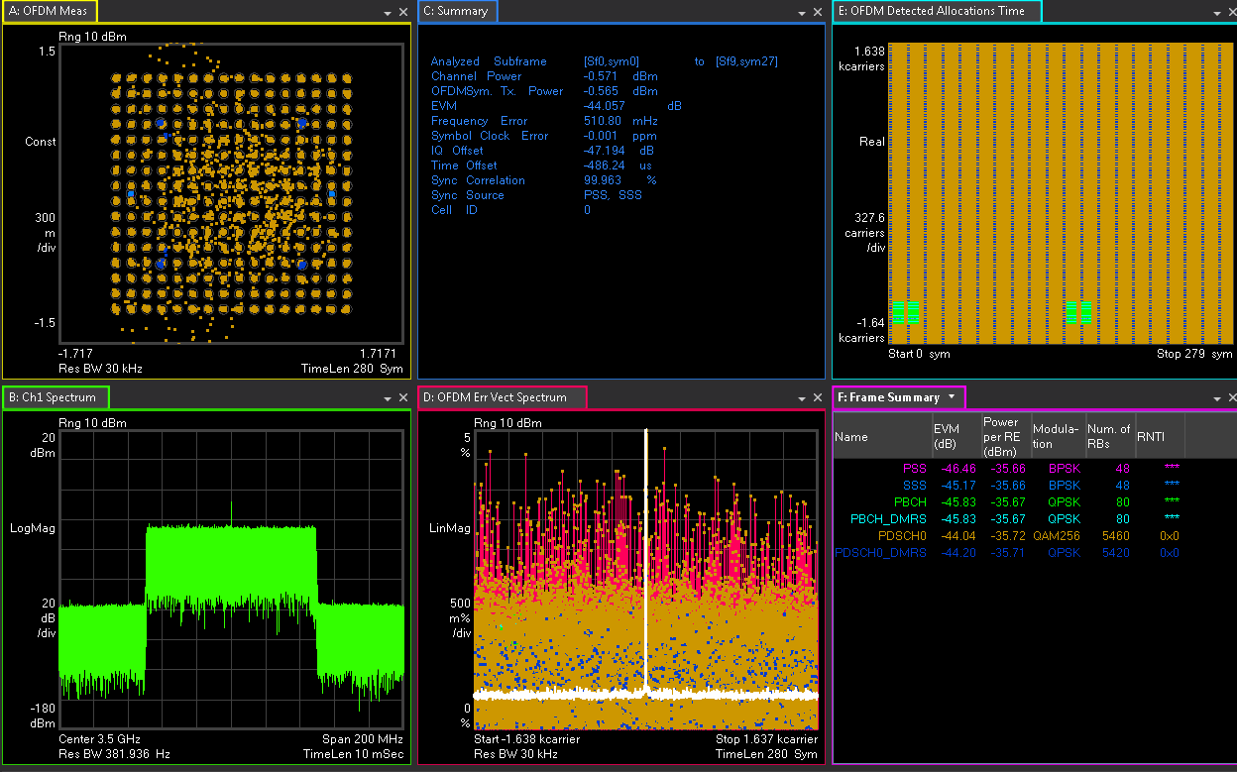
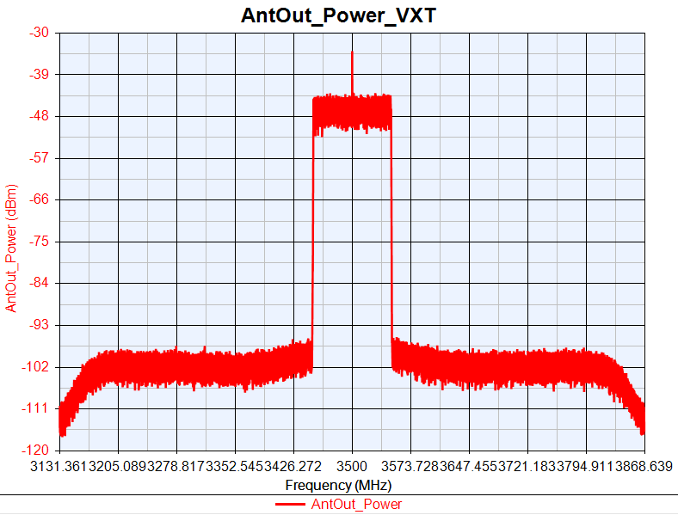
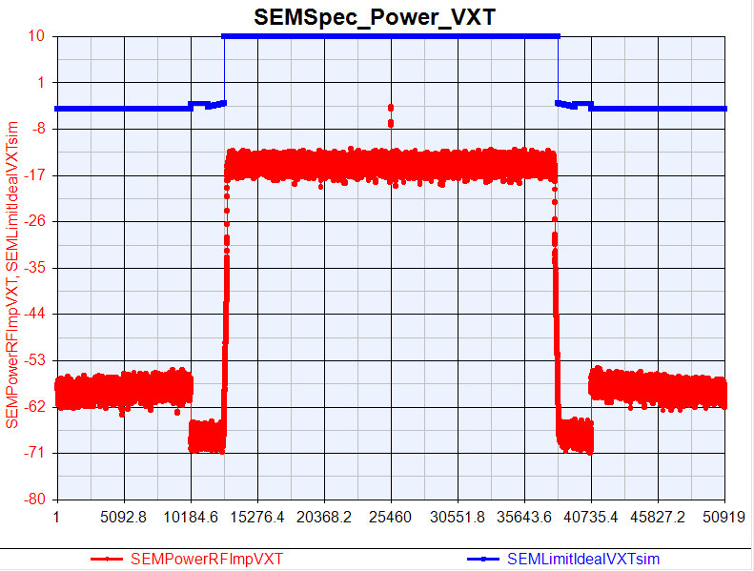
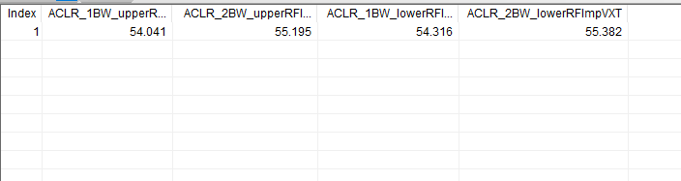
VXT_PhaseNoise =[100, -62.133, 1000, -71.072, 1e4, -83.607]
EVM:-44.057dB
IQoffset:-47.194dB

Slide 23
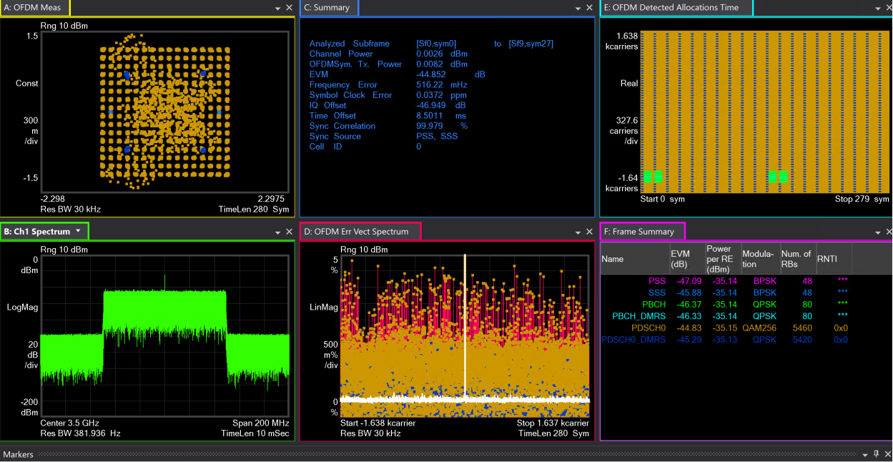
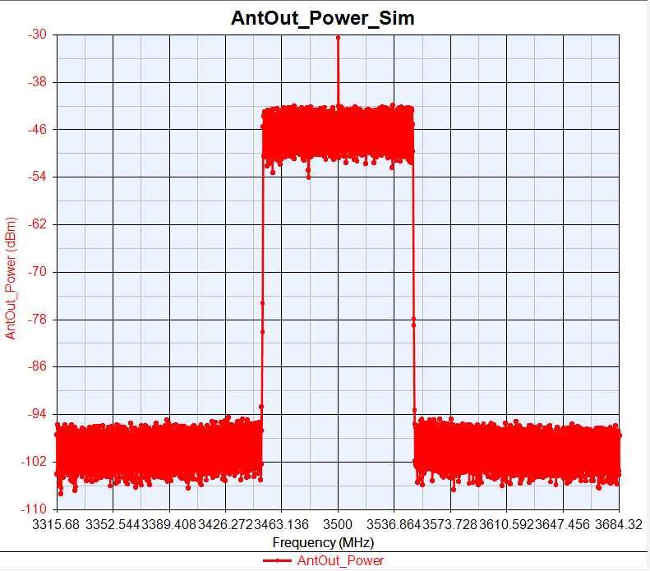
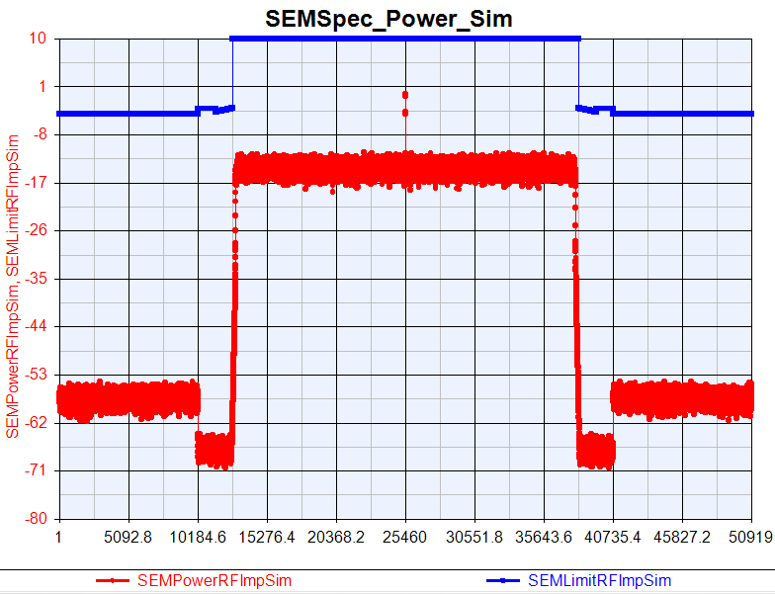
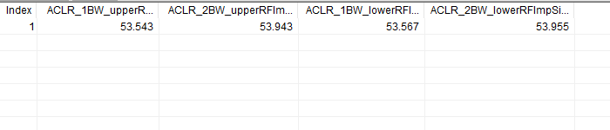
Sim_PhaseNoise =[100, -62.133, 1000, -71.072, 1e4, -83.607]
EVM:-44.852dB
IQoffset:-46.949dB

Slide 24

VXT SEM VS Sim SEM

Slide 25




VXT_PhaseNoise = [100, -57.133, 1000, -66.072, 1e4, -78.607]
EVM:-32.341dB
IQoffset:46.802dB

Slide 26




Sim_PhaseNoise = [100, -57.133, 1000, -66.072, 1e4, -78.607]
EVM:-32.359dB
IQoffset:-46.343dB

Slide 27

VXT SEM VS Sim SEM

Slide 28
DAC_Nbits Test
DAC_Nbits 14:
Power out=0dBm
DAC_Nbits=14
GainImbalance=0.002
IQ offset=0.0044
Phase Noise =[100, -97.133, 1000, -106.072, 1e4, -118.607];
PA_TOI=30
DAC_Nbits Change 12:
Power out=0dBm
DAC_Nbits=12
GainImbalance=0.002
IQ offset=0.0044
Phase Noise =[100, -97.133, 1000, -106.072, 1e4, -118.607];
PA_TOI=30
DAC_Nbits Change 10:
Power out=0dBm
DAC_Nbits=10
GainImbalance=0.002
IQ offset=0.0044
Phase Noise= [100, -97.133, 1000, -106.072, 1e4, -118.607];
PA_TOI=30

Slide 29
DAC_Nbits Test Compare
 | EVM(dB) |  |  | 1BW_Upper_ACLR |  |  | 1BW_Lower_ACLR
DAC Nbits | VXT | Sim | Delta | VXT | Sim | Delta | VXT | Sim | Delta
14 | -48.458 | -49.843 | 1.385 | 53.743 | 53.563 | 0.18 | 53.926 | 53.579 | 0.347
12 | -48.434 | -48.813 | 0.379 | 53.773 | 53.507 | 0.224 | 54.005 | 53.502 | 0.503
10 | -48.299 | -49.204 | 0.905 | 52.503 | 52.285 | 0.218 | 52.685 | 52.281 | 0.404

Slide 30
VXT_DAC_Nbits=14
EVM:-48.458dB
IQoffset:-47.301dB

Slide 31
Sim_ DAC_Nbits=14
EVM:-49.843dB
IQoffset:-47.106dB

Slide 32
VXT SEM VS Sim SEM

Slide 33




VXT_DAC_Nbits=12
EVM:-48.434dB
IQoffset:-47.231dB

Slide 34




Sim DAC_Nbits=12
EVM:-48.813dB
IQoffset:-47.094dB

Slide 35

VXT SEM VS Sim SEM

Slide 36




VXT_DAC_Nbits=10
EVM:-48.299dB
IQoffset:-47.494dB

Slide 37




Sim_DAC_Nbits=10
EVM:-49.204dB
IQoffset:-47.121dB

Slide 38

VXT SEM VS Sim SEM

Slide 39
Gain Imbalance Test
Gain Imbalance Change x10:
Power out=0dBm
DAC_Nbits=14
GainImbalance=0.02
IQ offset=0.0044
Phase Noise =[100, -97.133, 1000, -106.072, 1e4, -118.607];
PA_TOI=30
Gain Imbalance Change x15:
Power out=0dBm
DAC_Nbits=14
GainImbalance=0.03
IQ offset=0.0044
Phase Noise =[100, -97.133, 1000, -106.072, 1e4, -118.607];
PA_TOI=30

Slide 40
Gain Imbalance Test
Gain Imbalance Change x10:
Power out=0dBm
DAC_Nbits=14
GainImbalance=0.1
IQ offset=0.0044
Phase Noise =[100, -97.133, 1000, -106.072, 1e4, -118.607];
PA_TOI=30
Gain Imbalance Change x15:
Power out=0dBm
DAC_Nbits=14
GainImbalance=0.3
IQ offset=0.0044
Phase Noise =[100, -97.133, 1000, -106.072, 1e4, -118.607];
PA_TOI=30

Slide 41
Gain Imbalance Test Compare
 | EVM(dB) |  |  | 1BW_Upper_ACLR |  |  | 1BW_Lower_ACLR
Gain Imbalance | VXT | Sim | Delta | VXT | Sim | Delta | VXT | Sim | Delta
0.02 | -48.323 | -49.2 | 0.877 | 53.876 | 53.584 | 0.292 | 54.134 | 53.575 | 0.559
0.03 | -47.5 | -48.261 | 0.761 | 53.898 | 53.561 | 0.337 | 54.106 | 53.593 | 0.513
0.1 | -42.374 | -43.165 | 0.791 | 54.046 | 53.591 | 0.455 | 54.305 | 53.588 | 0.717
0.3 | -34.544 | -34.746 | 0.202 | 54.071 | 53.569 | 0.502 | 54.308 | 53.59 | 0.718

Slide 42




VXT_GainImbalance=0.02
EVM:-48.323dB
IQoffset:-47.442dB

Slide 43




Sim_GainImbalance=0.02
EVM:-49.2dB
IQoffset:-47.144dB

Slide 44

VXT SEM VS Sim SEM

Slide 45




VXT_GainImblance=0.03
EVM:-47.5dB
IQoffset:-47.344dB

Slide 46




Sim_GainImblance=0.03
EVM:-48.261dB
IQoffset:-47.139dB

Slide 47

VXT SEM VS Sim SEM

Slide 48




VXT_GainImbalance=0.1
EVM:-42.374dB
IQoffset:-47.161dB

Slide 49




Sim_GainImbalance=0.1
EVM:-43.165dB
IQoffset:-47.16dB

Slide 50

VXT SEM VS Sim SEM

Slide 51




VXT_GainImbalance=0.3
EVM:-34.544dB
IQoffset:-47.223dB

Slide 52




Sim_GainImbalance=0.3
EVM:-34.746dB
IQoffset:-47.117dB

Slide 53

VXT SEM VS Sim SEM

Slide 54
IQoffset Test
IQ offset Change 10dB:
Power out=0dBm
DAC_Nbits=14
GainImbalance=0.002
IQ offset=0.014
Phase Noise =[100, -97.133, 1000, -106.072, 1e4, -118.607];
PA_TOI=30
IQ offset Change 15dB:
Power out=0dBm
DAC_Nbits=14
GainImbalance=0.002
IQ offset=0.025
Phase Noise =[100, -97.133, 1000, -106.072, 1e4, -118.607];
PA_TOI=30

Slide 55
IQoffset Test
IQ offset Change 10dB:
Power out=0dBm
DAC_Nbits=14
GainImbalance=0.002
IQ offset=0.2
Phase Noise =[100, -97.133, 1000, -106.072, 1e4, -118.607];
PA_TOI=30
IQ offset Change 15dB:
Power out=0dBm
DAC_Nbits=14
GainImbalance=0.002
IQ offset=0.4
Phase Noise =[100, -97.133, 1000, -106.072, 1e4, -118.607];
PA_TOI=30

Slide 56
IQoffset Test Compare
 | EVM(dB) |  |  | 1BW_Upper_ACLR |  |  | 1BW_Lower_ACLR
IQ offset | VXT | Sim | Delta | VXT | Sim | Delta | VXT | Sim | Delta
0.014 | -48.308 | -49.806 | 1.498 | 53.839 | 53.603 | 0.236 | 54.134 | 53.586 | 0.548
0.025 | -48.302 | -49.553 | 1.251 | 53.852 | 53.602 | 0.25 | 54.143 | 53.607 | 0.536
0.2 | -41.065 | -42.133 | 1.068 | 54.045 | 53.421 | 0.624 | 54.269 | 53.449 | 0.82
0.4 | -32.981 | -33.456 | 0.475 | 54.07 | 53.377 | 0.693 | 54.284 | 53.388 | 0.896

Slide 57




VXT_IQoffset=0.014
EVM:-48.308dB
IQoffset:-40.798dB

Slide 58




Sim_IQoffset= 0.014
EVM:-49.806dB
IQoffset:-41.287dB

Slide 59

VXT SEM VS Sim SEM

Slide 60




VXT_IQoffset=0.025
EVM:-48.302dB
IQoffset:-36.779dB

Slide 61




Sim_IQoffset=0.025
EVM:-49.553dB
IQoffset:-36.658dB

Slide 62

VXT SEM VS Sim SEM

Slide 63




VXT_IQoffset=0.2
EVM:-41.056dB
IQoffset:-40.803dB

Slide 64




Sim_IQoffset=0.2
EVM:-42.133dB
IQoffset:-40.764dB

Slide 65

VXT SEM VS Sim SEM

Slide 66




VXT_IQoffset=0.4
EVM:-32.981dB
IQoffset:-42.814dB

Slide 67




Sim_IQoffset=0.4
EVM:-33.456dB
IQoffset:-42.827dB

Slide 68

VXT SEM VS Sim SEM

Slide 69
Combine Test
Orgin Para:
Power out=0dBm
DAC_Nbits=14
GainImbalance=0.002
IQ offset=0.0044
Phase Noise =[100, -97.133, 1000, -106.072, 1e4, -118.607];
PA_TOI=30
Change 5dB:
Power out=0dBm
DAC_Nbits=12
GainImbalance=0.01
IQ offset=0.0079
Phase Noise =[100, -87.133, 1000, -96.072, 1e4, -108.607];
PA_TOI=25
Change 10dB:
Power out=0dBm
DAC_Nbits=10
GainImbalance=0.02
IQ offset=0.014
Phase Noise =[100, -82.133, 1000, -91.072, 1e4, -103.607];
PA_TOI=20

Slide 70
Combine Test Compare
 | EVM(dB) |  |  | 1BW_Upper_ACLR |  |  | 1BW_Lower_ACLR
Combine Test | VXT | Sim | Delta | VXT | Sim | Delta | VXT | Sim | Delta
Origin Para | -48.256 | -49.847 | 1.591 | 53.746 | 53.591 | 0.155 | 53.966 | 53.578 | 0.388
Change 5dB | -45.294 | -46.33 | 1.036 | 50.969 | 51.347 | 0.378 | 51.21 | 51.369 | 0.159
Change 10dB | -37.388 | -37.69 | 0.302 | 43.794 | 44.096 | 0.312 | 43.969 | 44.182 | 0.213

Slide 71




VXT Origin
EVM:-48.256dB
IQoffset:-47.392dB

Slide 72




Sim Origin
EVM:-49.847dB
IQoffset:-47.147dB

Slide 73

VXT SEM VS Sim SEM

Slide 74




VXT Change 5dB
EVM:-45.294dB
IQoffset:-44.951dB

Slide 75




Sim Change 5dB
EVM:-46.33dB
IQoffset:-45.377dB

Slide 76

VXT SEM VS Sim SEM

Slide 77




VXT Change 10dB
EVM:-37.388dB
IQoffset:-40.8dB

Slide 78




Sim Change 10dB
EVM:-37.69dB
IQoffset:-41.316dB

Slide 79

VXT SEM VS Sim SEM

Slide 80
B2 Para and Imp Para
仪表参数：
Density=-158.7
IQoffset=0.0045
Gain Imb=0.002
PhaseNoise=[100 -98.57 1e3 -107.56 1e4 -121.67]
DAC_Nbits=14
Imp 测试参数：
Density=-158.7
IQoffset=0.045
Gain Imb=0.02
PhaseNoise=[100 -88.57 1e3 -97.56 1e4 -111.67]
DAC_Nbits=12
TOIout=20
Power Out=10dB

Slide 81
OTA Test
 | EVM(dB) |  |  | 1BW_Upper_ACLR |  |  | 1BW_Lower_ACLR
OTA Test | VXT | Sim | Delta | VXT | Sim | Delta | VXT | Sim | Delta
Ideal Signal | -42.26 | -42.29 | 0.03 | 44.46 | 43.096 | 1.364 | 44.84 | 43.104 | 1.736
Imp Signal | -34.409 | -34.924 | 0.515 | 41.013 | 40.712 | 0.301 | 40.823 | 40.744 | 0.079

Slide 82




Ideal NR Tx 100M Chamber Test
EVM=-42.26
IQ offset=-46.947

Slide 83




OTA Sim Tx Ideal NR 100M
EVM=-42. 29
IQ offset=-47.115

Slide 84

VXT SEM VS Sim SEM

Slide 85




Imp NR 100M Chamber Test
EVM=-34.409
IQ offset=-35.376

Slide 86




OTA Sim Imp Tx 100M NR
EVM=-34.924
IQ offset=-35.443

Slide 87

VXT SEM VS Sim SEM

Slide 88

B2 S21 Para

